Slide 1
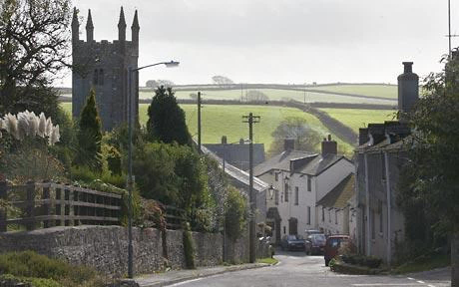
Lanreath Neighbourhood Plan
2nd Public Meeting: Lanreath Village Hall Thursday 9th June 2016

Slide 2
Agenda
Neighbourhood Plan – what is it for? – refresh
Evidence Base Report
LNP Questionnaire responses summary
LNP Framework and proposed policies
LNP Time Line – what happens next?
How to respond / who to contact
Questions / queries – are we on the right track?
(However please ask questions as we go)

Slide 3
What is a Neighbourhood Plan - Refresh
Neighbourhood planning gives communities the opportunity to direct the development of their areas through creating plans and policies.
Derives from the National Planning Policy Framework enacted through the Neighbourhood Planning (General) Regulations 2012.
A neighbourhood plan should support the strategic development needs set out in the Local Plan and plan positively to support local development.
A neighbourhood plan must address the development and use of land. Once ‘made’ (brought into legal force) the neighbourhood plan will become part of the statutory development plan. Applications for planning permission must be determined in accordance with the development plan, unless material considerations indicate otherwise.
Neighbourhood planning can inspire local people and businesses to consider other ways to improve their neighbourhood than through the development and use of land. They may identify specific action or policies to deliver these improvements. Wider community aspirations than those relating to development and use of land can be included in a neighbourhood plan, but actions dealing with non land use matters should be clearly identifiable. For example, set out in a companion document or annex.

Slide 4
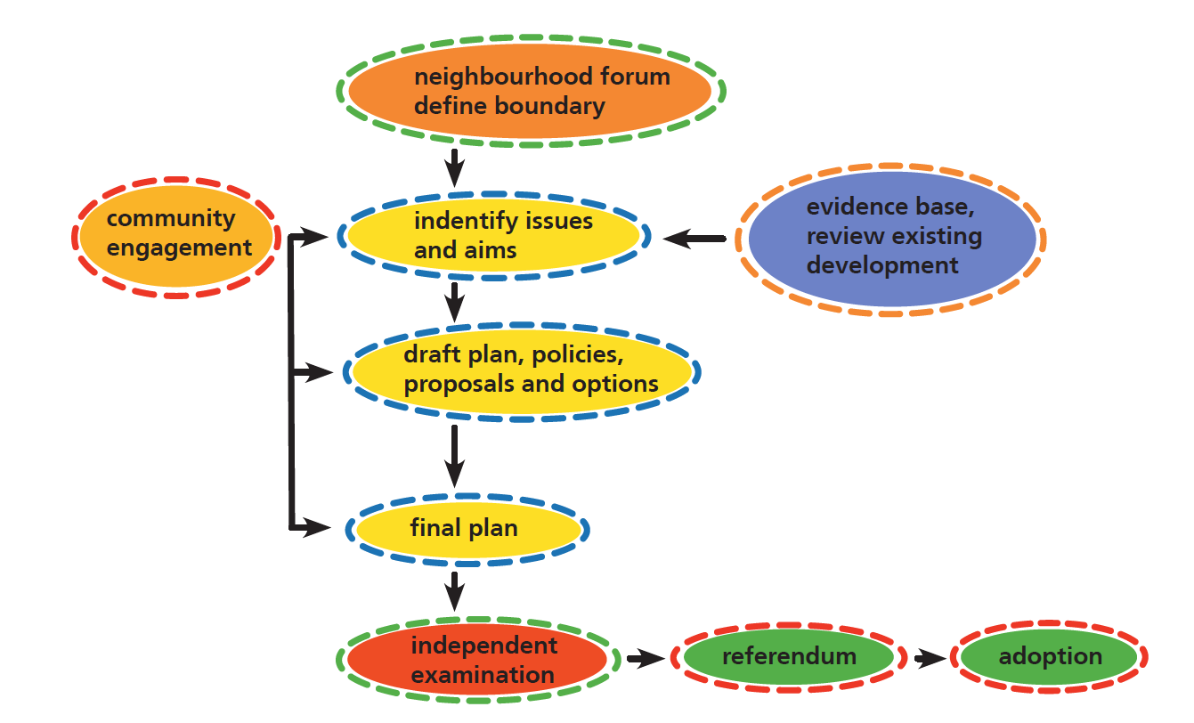
Neighbourhood Plan Process
Where we are now

Slide 5
Evidence Base Report
Provides an evidential base to demonstrate the needs of the community in an objective way and assists in supporting choices made in developing key themes and priorities in the Neighbourhood Plan.
The Parish Council (through LNDP Steering Group) commissioned AECOM to draft the Evidence Base Report using grant funds.
1st Draft Received 24th February 2016
Review and comment by Steering Group
Final Draft received 31st May 2016
Available on Website
Hard copies for review here and at Lanreath Village
Shop

Slide 6
Lanreath Neighbourhood Plan Questionnaire
Sent out to all households in Lanreath – by hand delivery or with ‘Lanreath Lifestyle’ distribution 1st week in February 2016.
Responses collected and collated into a Summary Report – available on website and hard copies available to view here and at Lanreath Village Shop.
There are approximately 220 residences in the Parish of Lanreath, accommodating about 425 parishioners that are eligible to vote.
A total of 77 completed questionnaires were returned. Some were completed by more than one respondent and therefore the returned questionnaires represented the responses of 110 parishioners representing 25.9% of the population of the Parish.
Thank you to all who took the time to respond

Slide 7
Age of Responders
In the 2011 census, 26.3% of the population of the Parish were in the 16 – 44 age group whereas only 6.9% of responses were received from this group.

Slide 8
Employment Status of Responders
High proportion of responders are retired compared with the proportion of the retired population in the Parish as a whole based on the 2011 Census data (18%).
The proportion of responses received from the parishioners in current employment (41.5%) was lower than the proportion of the population in all forms of employment across the Parish as detailed in the Evidence Base Report (66%).
The responses from students and disabled parishioners was broadly representative of these groups as detailed in the Evidence Base Report.

Slide 9
Business Responses
A total of 13 businesses responded to the questionnaire. Data collected for the Evidence Base Report indicates that there are at least 31 separate businesses in the Parish. The responses therefore represent approximately 42% of the business community

Slide 10
Lanreath Neighbourhood Plan Framework
Steering Group used Evidence Base Report and feedback from LNDP Questionnaire to develop the Lanreath Neighbourhood Plan Framework Document.
In developing the framework the Steering Group were mindful that the views of large percentage of the Community are not represented in responses to the questionnaire.
Objectives and Policies cannot reflect the full diversity of opinion in the community and therefore some individual opinions and positions may not represented.
The Steering Group would like to use this opportunity to seek views from the widest section of the community.
The Lanreath Neighbourhood Plan Framework document is available on the Website and hard copies are available for review at the Lanreath Village shop and here today.

Slide 11
Lanreath Neighbourhood Plan Framework
Steering Group Mission
‘Shaping the future development of Lanreath while safeguarding and enhancing what is valued by the community’
Taking Guidance from LNDP Questionnaire feedback and Evidence Base Report
Vision for the Future of Lanreath
‘Conserve and enhance the built, economic and natural environment of Lanreath Parish and retain and promote a healthy, vibrant and sustainable community.’
Develop Objectives
Draft Policies

Slide 12
Lanreath Neighbourhood Plan Framework
Objectives and draft Policies grouped under six subject headings:
Housing Development
Commercial Development
Environment and Heritage
Community
Carbon Reduction / Energy Efficiency and Energy Production
Local Services and Infrastructure

Slide 13
Housing Development Background
Lanreath is in the Liskeard and Looe Community Network Area (CNA). In the latest iteration of the Cornwall Local Plan the CNA should provide around 2,650 dwellings between 2010 and 2030. Of these 1250 will be in Liskeard with the remaining 1400 in the residual area.
Lanreath is not classified in the Cornwall Settlement Hierarchy (a series of metrics developed in 2011 to assist in determining housing allocation and development across Cornwall), and any new housing should be delivered through the Neighbourhood Development Plan.
By the end of 2016 thirty (30) new residential properties will have been built in the Parish since 2010. Of these ten (10) will be affordable homes. This is a significant contribution to the delivery of the housing requirement for the Liskeard and Looe CNA.
The Neighbourhood Development Plan seeks to accommodate additional housing growth as required, particularly to meet local need, whilst retaining the essential rural character of Parish.
Small scale housing development will be supported at a level that is commensurate with, and will help sustain, social and community facilities available in the Parish.
Applications for new housing development will be determined on their merits in light of Local and the following Neighbourhood Plan policies:

Slide 14
Housing Policies
H1
Only planning applications for Minor Developments will be considered and new residential developments shall to be limited to single or small clusters of houses on the periphery of, and on land adjoining, the current Village of Lanreath with good access to the B3359 or the Lanteglos Highway / Bodinnick road.
Justification: Accords with view of majority of responders – and Cornwall Council Strategic Policy - no overall consensus on a specific location for future residential development.
H2
Change of use: Consideration will be given to the conversion of redundant farm buildings to residential use subject to other policies in this Plan.
Justification: Accords with view of majority of responders and provides additional residential accommodation without adding to the built environment

Slide 15
Housing Policies (Cont’d)
H3
The proportion of affordable / social housing in any new development shall accord with current Cornwall Planning rules but a higher proportion may be required as dictated by local need.
Justification: Majority of responders support current allocation (50%), however, the number of reported occupants that are likely to require their own social or affordable residence in the Parish by 2030 , as detailed in the responses, was 9. If this number is representative of needs across the Parish, and given that 25.9% of the Parish responded to the Questionnaire, by extrapolation, the total number of occupants across the Parish that are likely to require their own social or affordable housing by 2030 could be as high as 35.
In Feb 2015 Cornwall Council advised: ‘Affordable housing need evidenced through Homechoice indicates 18 households currently registered. Whilst all 18 households would qualify for local housing, only 5 households indicated that their first preference is to remain in the parish. This may reflect a need to live elsewhere, or anticipation that there may be earlier or increased opportunities available elsewhere. The Plan may wish to consider whether further survey work or evidence gathering is required.’
At end of 2016 there will be a total of 32 affordable homes in Lanreath

Slide 16
Housing Policies (Cont’d)
H4
Local housing need shall be determined by establishing a Lanreath Local Housing Needs Register. The Register is in addition to that maintained by Cornwall Council. The Register shall be developed and administered by the Lanreath Parish Council to provide guidance on the allocation of social and affordable housing in new residential developments in the Parish. The qualifying Local Connection criteria for the Lanreath Housing Need Register will be, in order of priority, as follows:
1. Those with a local connection with the Lanreath Parish
2. Those with a local connection with the parishes adjoining the Lanreath
3. Those with a local connection with the previous Caradon district area
4. Those with a local connection with Cornwall
Justification: Aligns with the view majority of responders and uses Cornwall Council’s current ‘local connection ’ criteria – also aligns with comment in Cornwall Designation Officer’s Report for Lanreath Neighbourhood Plan application, in respect of local affordable housing requirements: ‘The Plan may wish to consider whether further survey work or evidence gathering is required’.

Slide 17
Housing Policies (Cont’d)
H5
Retrospective Planning applications will not receive Parish Council approval where they are not in compliance with other Planning Policies in this Plan.
Justification: Aligns with view of majority of responders but does not close the door for exceptional cases that otherwise comply with LNP
H6
Any new residential housing shall be designed to blend in with residential properties already existing in the immediate area and the available green space within the curtilage of each property shall meet planning regulation requirements and be similar to those of adjacent properties.
Justification: Aligns with view of majority of responders that new developments should be in harmony with adjacent properties

Slide 18
Housing Policies (Cont’d)
H7
New residential properties shall be limited to a maximum of 2 storeys
Justification: Aligns with view of majority of responders that new developments should be in harmony with adjacent properties
H8
New residential properties shall incorporate a garage or be provided with adequate off-road parking for private vehicles appropriate to the number of occupants of the property but with a minimum provision of facilities for a single vehicle.
Justification: Aligns with view of majority of responders that LNP should address parking issues.

Slide 19
Commercial Development Background
In order to maintain a vibrant local community and reduce the carbon footprint of travel-to-work requirements, the provision of additional employment opportunities in the Parish is encouraged.
Planning applications for new small-scale commercial development and for the modernisation and development of existing commercial premises and businesses in the Parish will be favourably reviewed subject to Regulations and the following Neighbourhood Plan policies:

Slide 20
Commercial Policies
C1
Planning applications for new small-scale (<150m2) commercial and light industrial premises, including farm buildings not exempt from building regulation permission will be considered against the following criteria:
- Suitable infrastructure including access to main roads
- Adequate on-site parking for employees and / or customers
- Acceptable impact on the adjacent residential population
Justification: Aligns with view of majority of responders (in favour or neutral) in support of limited commercial development and provision of additional employment in the Parish while minimising impact on the community.

Slide 21
Commercial Policies (Cont’d)
C2
Change of use: Consideration will be given to the conversion of redundant farm buildings to short-term holiday let accommodation or for commercial / light industrial use subject to other policies in this Plan.
Justification: Accords with view of majority of responders and may provide additional commercial premises or encourage local tourism without adding to the built environment.

Slide 22
Environment and Heritage Background
The natural rural environment of the Parish, which contains an Area of Great Landscape Value, is highly valued and contributes significantly to the health and welfare of the community.
The Cornish Hedges which border fields, lanes and highways in the Parish provide a habitat for a diverse range of flora and fauna.
The Parish has a rich heritage and contains two Scheduled Ancient monuments, eleven listed buildings and 4 Sites of Archaeological Importance.
Protection of heritage assets and the maintenance and enhancement of green infrastructure in the Parish is of critical importance and shall be delivered through Regulations and the Neighbourhood Plan including the following specific Policies:

Slide 23
Environment and Heritage Policies
EH1
Planning applications for any new residential or commercial development shall not impact on existing footpaths, bridleways or public green open spaces.
EH2
Residential or Commercial Planning applications that provide for additional green spaces for public access and recreation will be favourably considered
EH3
The impact on Cornish Hedges, mature trees, Listed Buildings, Scheduled Monuments and Sites of Archaeological Importance in the Parish shall be considered in any new planning applications for residential or commercial developments.
Justification: Accords with view of majority of responders and current planning policy framework.

Slide 24
Community Background
Lanreath fosters a vibrant community spirit with a number of diverse community groups active within the Parish.
The following specific Neighbourhood Plan policies are intended to sustain and improve social interaction and promote the associated health and well-being of the community.

Slide 25
Community Policies
C1
Planning applications for additional community facilities or extensions to existing community facilities shall be favourably reviewed subject to Regulation and compliance with other Policies in this Plan.
C2
Planning applications for the provision of, or modification to, a village public house and / or restaurant as a community facility will favourably considered subject to compliance with Regulations and other Policies in this Plan.
Justification: Accords with view of majority of responders – who wish to see additional amenities and a return of the ‘Pub’.

Slide 26
Carbon Reduction / Energy Efficiency and Energy Production
The importance of carbon reduction and energy saving / generation technologies is acknowledged.
The Parish contains 3 medium sized and two smaller sized commercial wind turbines. Any further development of carbon reduction or energy efficient technologies will comply with current regulation and be considered against the overall impact on the social, economic and natural environments of the Parish and the following specific policies:

Slide 27
Carbon Reduction / Energy Efficiency and Energy Production Policies
EE1
Where this aligns with Regulations, planning applications for the development of small scale carbon reduction or energy saving / generation projects will be evaluated against the following criteria:
- Majority support of the Community
- Benefit to the Community
- Impact on the social, economic and natural environments of the Parish.
Justification: Acknowledges that overarching Regulations prevail but accords with view of majority of responders in circumstances where LNP prevails and reflects ministerial statement by Secretary of State for Communities and Local Government (Greg Clark) on 18 Jun 2015

Slide 28
Carbon Reduction / Energy Efficiency and Energy Production Policies (Cont’d)
EE2
No areas suitable for the development of further medium or large commercial wind turbines have been identified. Where this aligns with Regulations, planning applications for the development of medium and large wind turbines, solar farms or other industrial scale carbon reduction or energy saving / generating projects within the Parish will not be supported
Justification: Acknowledges that overarching Regulations prevail but accords with view of majority of responders in circumstances where LNP prevails.

Slide 29
Local Services and Infrastructure Background
The importance of early learning is recognised and the Parish already contains a nursery facility, the Ladybirds.
The contribution of an infant and primary school in attracting and sustaining younger families in the community is acknowledged.
Lanreath village School was closed in 2007 with only 11 pupils on roll.
New residential housing developments in Pelynt and East Taphouse may place a future strain on admissions for children in the Lanreath Parish to Pelynt and Braddock Schools.
Should a future need arise, consideration for re-establishing a school in the Parish is addressed in the following Policies:

Slide 30
Local Services and Infrastructure Policies
LS1
Planning applications for the establishment of an infant / primary school adjacent to the Village of Lanreath will be favourably considered subject to compliance with Regulations and other Policies in this Plan.
LS2
Any proposals for the establishment of a new school shall take into consideration the impact on adjacent residential and/or commercial properties and provide the following:
- safe access to the school for pupils
- safe access and adequate parking for vehicles used to drop-off and collect pupils and for school staff
adequate safe play and recreation areas for the pupils within the curtilage of the school.
Justification: Accords with comments from responders on the importance of a school to the community and provides a framework within the LNP should a planning application for a new facility be received in the future.

Slide 31
What happens next? LNP Timeline.

Slide 32
How to Respond / Who to Contact
Details will be published in Lanreath Lifestyle ahead of 6 week official Public Consultation period but comments may be directed through the Steering Group Chairman:
Peter Seaman
Email. pandcseaman@aol.com
01503 220726
or through the Parish Clerk
Lynda Rigler
Email. lyndarigler@Tiscali.co.uk

Slide 33
Questions / Queries – Are we on the right Track?
Thank you for your engagement and assistance

